Slide 1
Chat Application
By Sushant V

Slide 2
Introduction
Overview of the Project: Explain the goal of developing a real-time chat application. Highlight the importance of real-time communication in modern web applications.

Slide 3
Project Description
Project Aim: Create a web-based platform where users can join chat rooms and exchange messages in real-time. Ensure a smooth and interactive chat experience using HTML, CSS, and JavaScript.

Slide 4
Technologies Used
HTML:
Structure the user interface and chat rooms
CSS:
Style the application for visual appeal and responsiveness.
JavaScript:
Handle real-time communication and user interactions
.WebSockets:
Enable instant message exchange between users

Slide 5
Project Requirements
User Interface:
Design an intuitive and visually appealing chat interface.
Create a layout with a list of chat rooms, a message display area, and an input field.
Ensure the interface is responsive and works across different devices.

Slide 6
User Interface Design
Key Elements:
Chat Room List: Display available chat rooms for users to join.
Message Display Area: Show real-time messages from users in the selected chat room.
Input Field: Allow users to type and send messages.
Responsive Design:
Use media queries and flexible layouts to ensure usability on mobile and desktop devices.

Slide 7
JavaScript Logic
Handling Messages:
Capture user input and send messages via WebSockets.
Display incoming messages in the chat interface in real-time.
Room Management:
Allow users to switch between different chat rooms.
Ensure smooth transitions without refreshing the page.

Slide 8
Responsive Design
Adapting to Different Devices:
Discuss how the chat interface adjusts to various screen sizes.
Use of CSS Grid/Flexbox and media queries to create a fluid layout.
Code Snippet Example:
Show a snippet demonstrating responsive design techniques.

Slide 9
User Experience
Interactivity:
Highlight the importance of a responsive and engaging user interface.
Smooth animations and real-time updates for a seamless chat experience.
Feedback Mechanisms:
Visual indicators for message sending, receiving, and connection status.

Slide 10
Challenges & Solutions
Challenge 1: Managing Real-Time Communication.
Solution: Utilize WebSockets for low-latency messaging.
Challenge 2: Ensuring a Responsive Design.
Solution: Implement CSS best practices and test across devices.
Challenge 3: Maintaining Smooth User Experience.
Solution: Optimize JavaScript performance and user interface responsiveness.

Slide 11
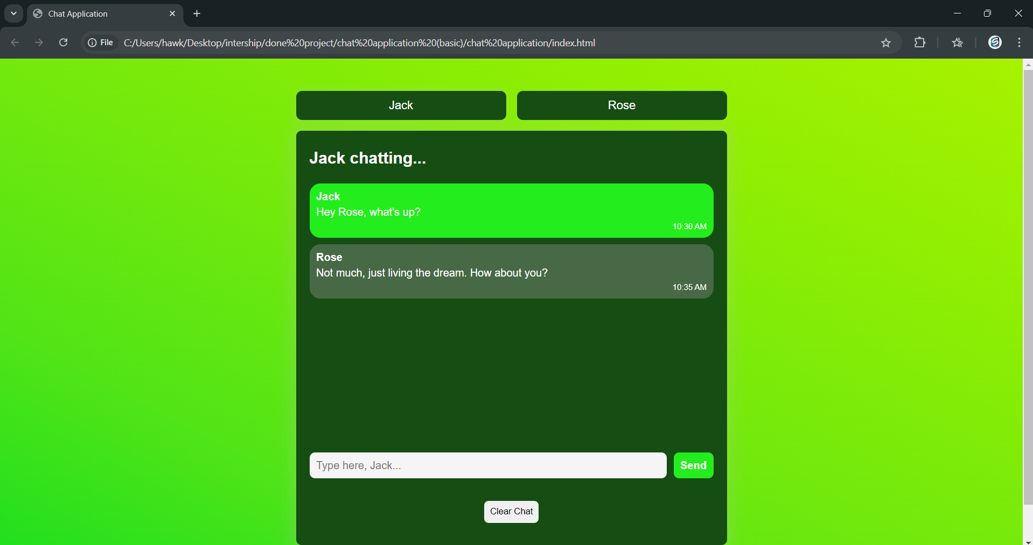
Project Demo
Live Demonstration:
Walkthrough of the chat application.
Show the process of joining a room, sending messages, and receiving messages in real-time.
Demonstrate responsiveness by resizing the browser window or using a mobile device.

Slide 12
Conclusion
Recap of Key Points:
Discuss the main features: user interface, real-time messaging, responsiveness.
Final Thoughts:
The significance of combining design, functionality, and real-time communication in web development

Slide 13
Thank you

